Slide 1
CSTE 3207
Session: 2020-21

Slide 2
Optical Fiber Communication

Slide 3
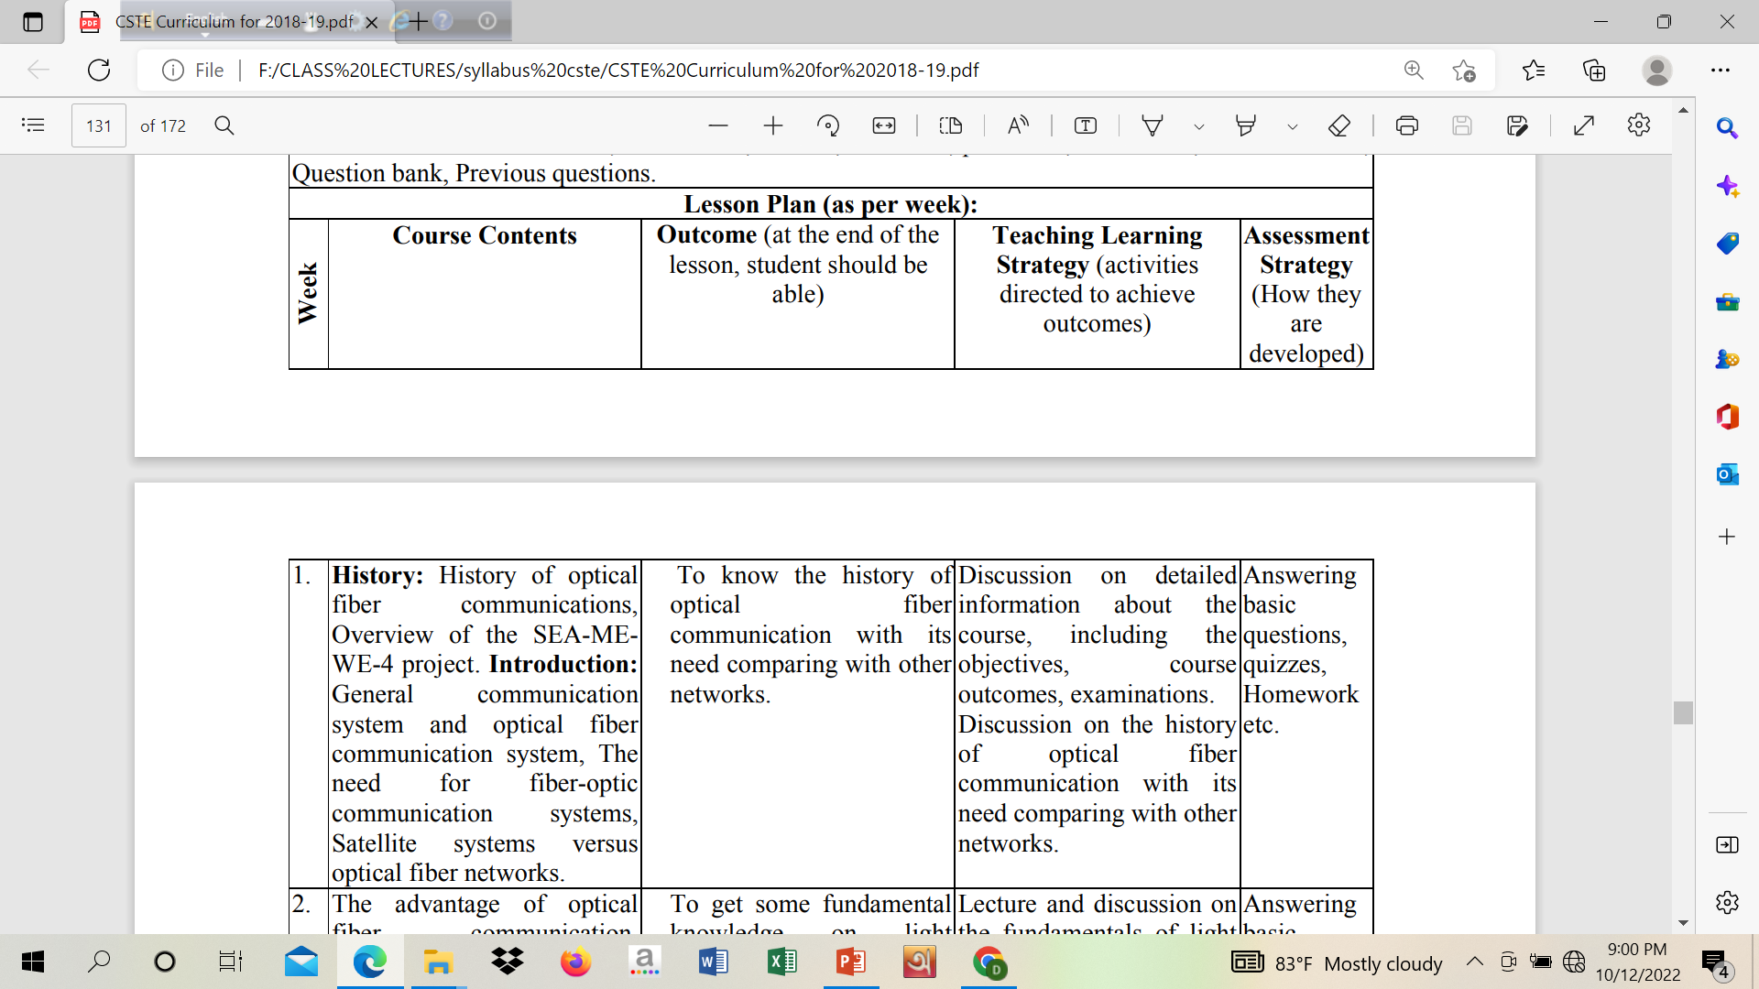

Slide 4
Outline
Historical development
SEA ME WE-4
General Communication vs Optical Fiber Communication
Need
Satellite Communication vs Optical Fiber Communication

Slide 5
Historical Development

Slide 6
Historical Development
Limited information transfer: signal fires, reflecting mirrors, signaling lamps use of visible optical carrier waves or light for communication.
1880 Alexander Graham Bell: Proposed photophone:Invention of telephone modulated sunlight with a diaphragm giving speech transmission over a distance of 200m.
Early part of 20th century: Limited to mobile low capacity communication links. Low capacity because lack of suitable light source, light transmission problem through atmosphere due to fog, rain, snow, dust, atmospheric turbulence. Radio and microwave less affected by the atmospheric conditions.

Slide 7
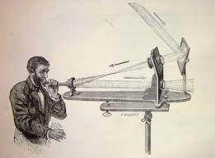
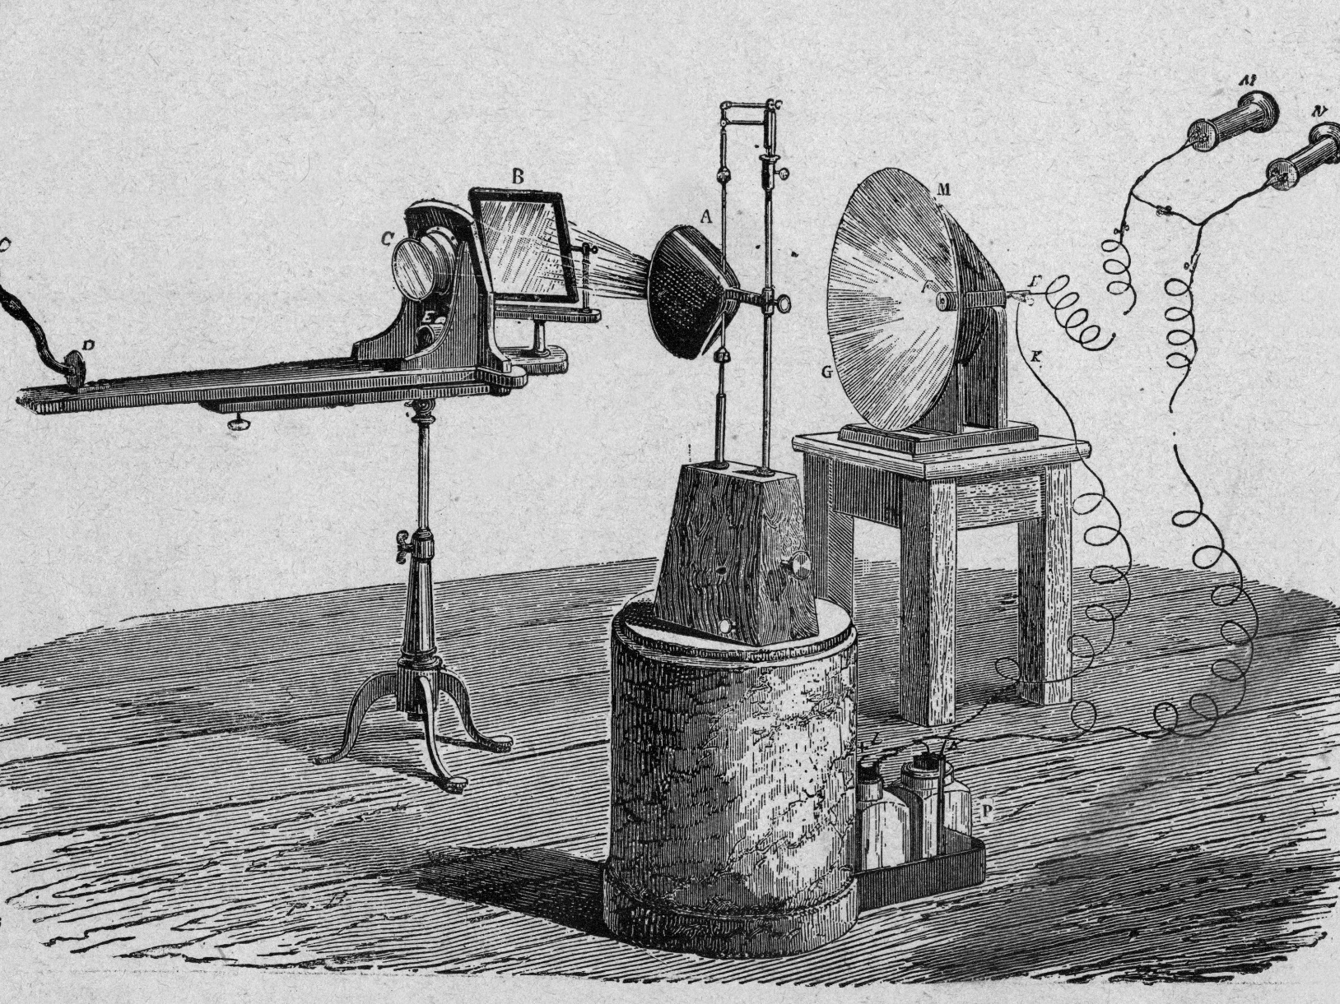
Bell’s Photophone

Slide 8
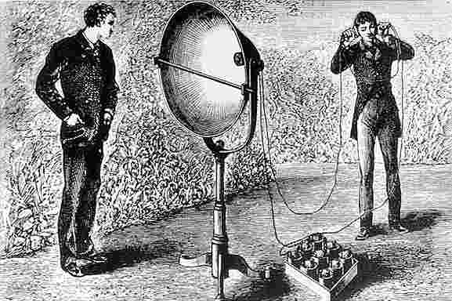
Bell’s Photophone

Slide 9
Historical Development
Limited amount of information transfer: Information carrying capacity is directly related to the bandwidth (BW) or frequency extent of modulated carrier. Theoretically, the greater the carrier frequency the larger the available transmission BW and thus the information carrying capacity. For this reason radio communication was developed to higher frequencies (VHF, UHF) and even more microwave, millimeter wave transmission.
Communication at optical frequencies increase the BW by a factor of 10⁴ over microwave transmission.

Slide 10
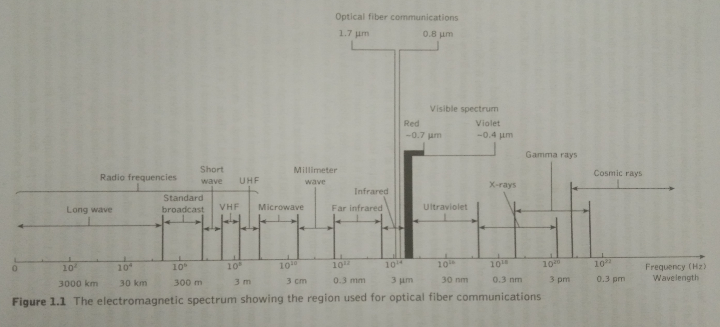
Historical Development

Slide 11
Historical Development
1960: Invention of LASER (light source)- powerful coherent light source –Free space optical communication links have been implemented (limited)- possibility of modulation at high frequency for the optical communication.
Study of optical components to achieve reliable information transfer using a light wave carrier.
1966: Kao and Hockham and Werts: Proposal for optical communication via dielectric medium/ waveguide/ optical fiber- fabricated from glass to avoid degradation of the optical signal by the atmosphere were made.

Slide 12
Historical Development
Problems finding:
Initially OF shows high attenuation 1000dB/km compared to coaxial cable 5 to 10 dB/km.
Jointing the fiber cables.
Continuous research findings (after 10 years)- attenuation 5 dB/km and suitable low loss jointing techniques.
Since optical frequencies are accompanied by extremely small wavelengths the development of all these optical components essentially required a new technology.
Semiconductor optical source (injection LASERs and LED) and detectors (photodiode, phototransistors) are designed and fabricated that are compatible in size with optical fibers.

Slide 13
Historical Development
Problems finding:
Initially semiconductor LASER exhibits low lifetimes (few hours).
Advancement of device structure exhibits lifetimes greater than 1000 hours to 7000 hours (1973-1977).
Devices (LASER) fabricated from alloys of gallium-arsenide (AlGaAs).
Light emission in near infrared region (wavelength: 0.8 and 0.9 micrometer)
Wavelength range was extended to 1.1 to 1.6 micrometer by the use of other semiconductor alloys to take advantage of enhanced performance characteristics displayed by optical fibers over this range.

Slide 14
Historical Development
For the longer wavelength region 1.3 and 1.55 micrometer, semiconductor LASERs and also the simpler structured LEDs based on the quaternary alloys InGaAsP grown lattice matched to InP substrate (base material) have been available late 1980s -lifetime 25 years(operated at 10 degree C) former and 100 years (operated at 70 degree C) later device types.
Material growth and fabrication technology for telecommunication application is now mature.

Slide 15
Historical Development
Single mode fiber:
direct modulation of commercial semiconductor lasers at 2.5 Gbit/s over single mode fiber transmission upto 200km at a wavelength of 1.55µm and extended upto 10 Gbit/s. Recent research and development has focused on 40Gbit/s where external laser modulation is required using Mach-Zehnder or electroabsorption modulator- wavelength 1.3µm where fiber intramodal dispersion is minimized and transmission BW is maximized for the single mode fiber.

Slide 16
Historical Development
Fiber type quickly came to dominate system application within telecommunication.
1982: initial field trial demonstration
2002: silica glass fiber losses 0.1484 dB/km were reported at 1.57 µm. But chromatic dispersion is greater at this wavelength thus limiting the maximum BW for single mode fiber.
Very low loss and low dispersion at 1.55µm with the advanced single mode fiber structures commercially available : namely- low water peak fiber and nonzero dispersion shifted fiber.

Slide 17
Historical Development
Recent years: application of fluoride fibers for even longer wavelength in the mid infrared (2-5 µm) and the far infrared (8-12 µm) regions have declined due to their failure to demonstrate practically. Theoretically predicted extremely low fiber losses combined with the emergence of optical amplifiers suitable for use with silica based fibers.
Photonic crystal fiber (phenomena of photonic bandgaps): shows unusual property, they only transmit a single mode light- new single mode fiber type which can carry more optical power than a conventional one. Further class a large hollow core fiber provide dispersion compensation on long haul fiber links- not commercially available.
Conventional fiber components: splices, connector, couplers etc.
Active optoelectronic devices: sources, detectors, amplifiers etc.

Slide 18
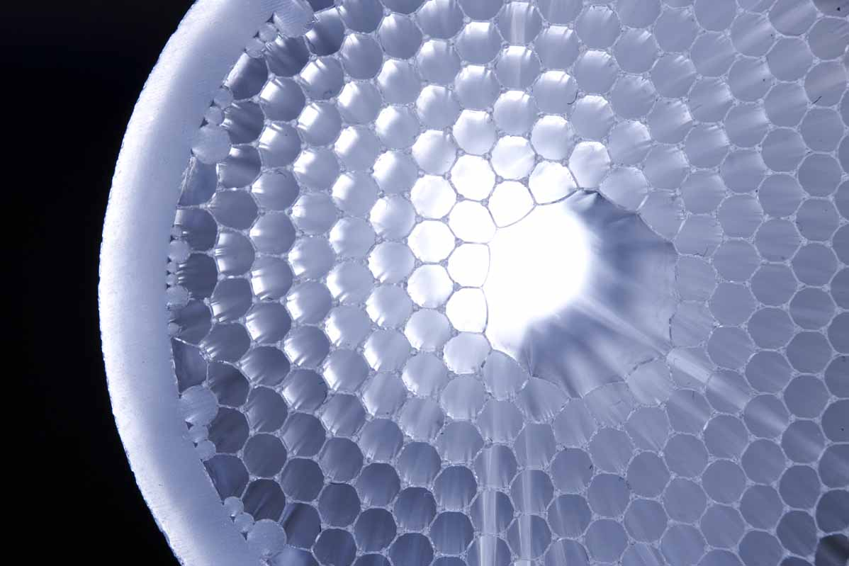
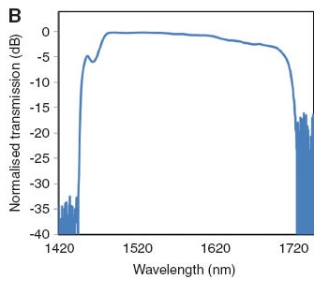
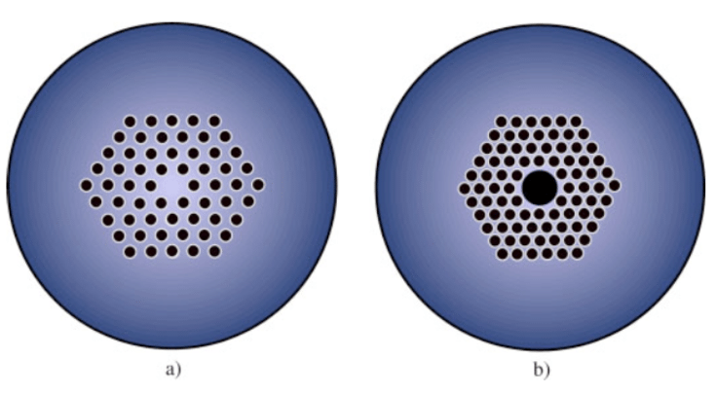
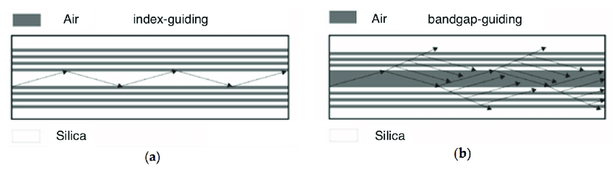

Slide 19
Photonic Crystal fiber/Photonic Bandgap
Optical fibers where light is guided based on a photonic bandgap effect.
The conceptually simplest kind of realization is a kind of two-dimensional Bragg mirror.
Bragg fibers, was based on concentric rings with different refractive index. Later, a special type of photonic crystal fiber has been developed, which also implements guidance with a photonic bandgap, but in this case based on tiny air holes.
The refractive index of the core itself can be lower than that of the cladding structure. The core can even be hollow (→ hollow-core fibers), so that its refractive index is that of air (close to 1).

Slide 20
Photonic Crystal fiber/Photonic Bandgap
As most of the light is then propagating in air rather than in glass (air-guiding fibers).
However, photonic bandgap fibers are generally more difficult to produce due to their tight fabrication tolerances, have a limited bandwidth for low-loss transmission, and often exhibit relatively high propagation losses. It is also substantially more difficult to understand and model their propagation characteristics, compared to index-guiding fibers.

Slide 21
Photonic Crystal fiber/Photonic Bandgap
The lowest reported attenuation of solid core photonic crystal fiber is 0.37 dB/km, and for hollow core is 1.2 dB/km.
PCF is now finding applications in fiber-optic communications, fiber lasers, nonlinear devices, high-power transmission, highly sensitive gas sensors, and other areas.

Slide 22
SEA ME WE-4

Slide 23
SEA ME WE-4
South East Asia–Middle East–Western Europe 4 (SEA-ME-WE 4, SMW4) is an optical fiber submarine communications cable system that carries telecommunications between Singapore, Malaysia, Thailand, Bangladesh, India, Sri Lanka, Pakistan, United Arab Emirates, Saudi Arabia, Egypt, Italy, Tunisia, Algeria and France. It is intended to be a complement to, rather than a replacement for, the SEA-ME-WE 3 cable. The cable is approximately 18,800 kilometers long, and provides the primary Internet backbone between South East Asia, the Indian subcontinent, the Middle East and Europe.
The SMW4 cable system consists of two fiber pairs, with initial design capacity of 1.28Tbps, upgraded to 4.6Tbps in 2015.
The SMW4 cable system was ready for service on December 13, 2005.
The SMW4 project costs about US$500 million, supplier by ASN and Fujitsu jointly.

Slide 24
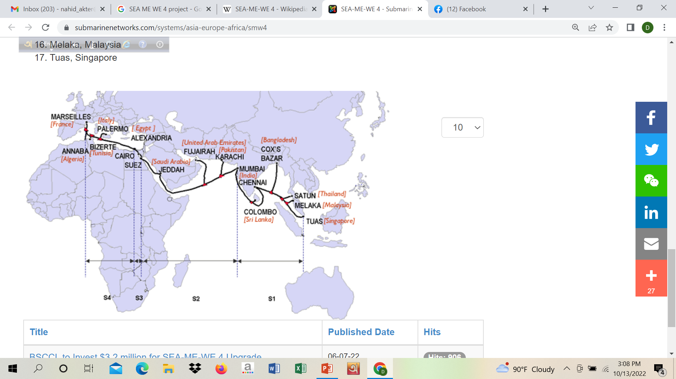
SEA ME WE-4

Slide 25
SEA ME WE-4
The SMW4 Consortium comprises 16 telecom operators:
Algérie Télécom, Algeria
Bharti Infotel Limited, India
Bangladesh Submarine Cable Company Limited (BSCCL), Bangladesh
CAT Telecom Public Company Limited, Thailand
Emirates Telecommunication Corporation (ETISALAT), UAE
France Telecom, France
MCI, United States
Pakistan Telecommunication Company Limited, Pakistan
Singapore Telecommunications Limited (SingTel), Singapore
Sri Lanka Telecom PLC (SLT), Sri Lanka
Saudi Telecom Company (STC), Saudi Arabia
Telecom Egypt (TE), Egypt
Telecom Italia Sparkle S.p.A., Italy
Telekom Malaysia Berhad (TM), Malaysia
Tunisie Telecom, Tunisia
Tata Communications, India

Slide 26
SEA ME WE-4
The SMW4 cable system has 4 segments:
S1 - Tuas to Mumbai
S2 - Mumbai to Suez
S3 - Suez to Alexandria
S4 - Alexandria to Marseille

Slide 27
SEA ME WE-4
The SMW4 cable system lands at the following 17 cable landing stations:
Marseille, France
Annaba, Algeria
Bizerte, Tunisia
Palermo, Italy
Alexandria, Egypt
Cairo, Egypt (overland)
Suez, Egypt (overland
Jeddah, Saudi Arabia
Fujairah, United Arab Emirates
Karachi, Pakistan
Mumbai, India
Colombo, Sri Lanka
Chennai, India
Cox's Bazar, Bangladesh
Satun, Thailand
Melaka, Malaysia
Tuas, Singapore

Slide 28
General vs OF Communication System

Slide 29
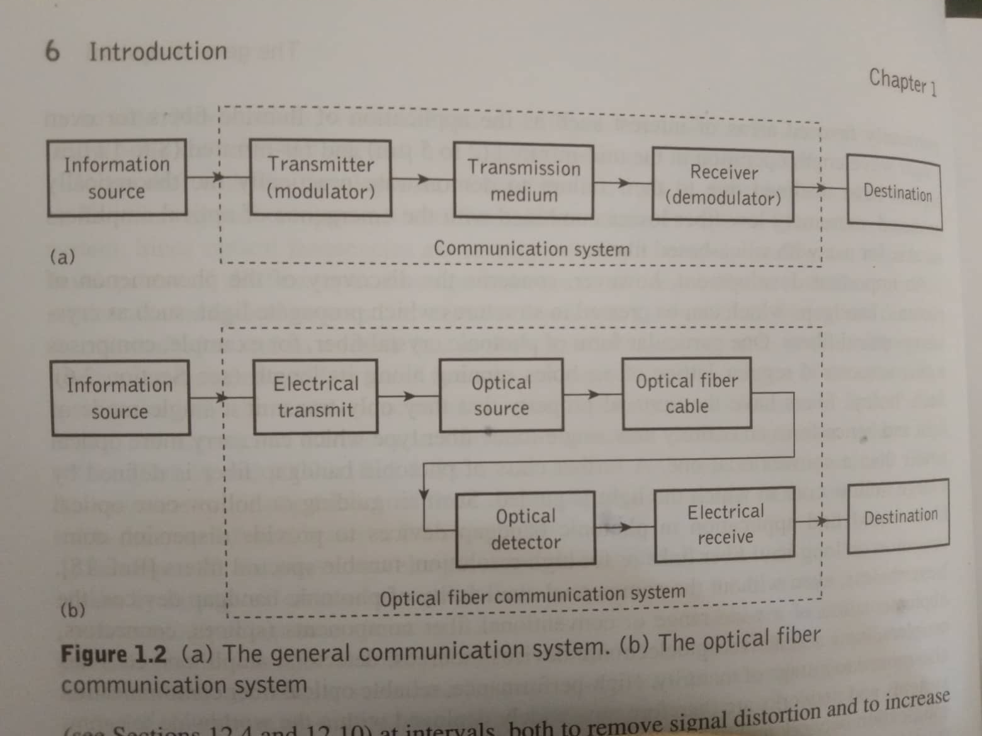

Slide 30
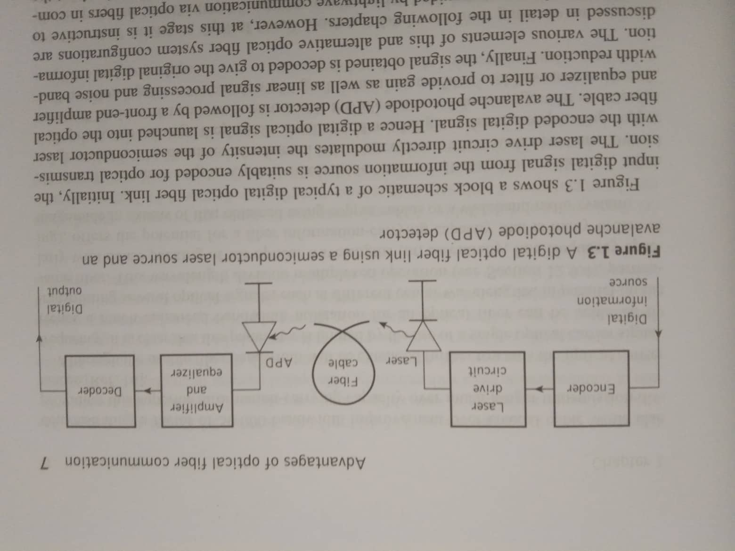
General vs OF Communication System

Slide 31
Need for OF Communication System
Fiber is preferred over electrical cabling due to lower attenuation and interference when high bandwidth, long distance, or immunity to electromagnetic interference is required.
This type of communication can transmit voice, video, and telemetry through local area networks or across long distances.
Optical fiber is used by many telecommunications companies to transmit telephone signals, internet communication, and cable television signals. Researchers at Bell Labs have reached a record bandwidth–distance product of over 100 petabit × kilometers per second using fiber-optic communication.

Slide 32
Need for OF Communication System
It is also need for other industries, including medical, defense, government, industrial and commercial.
In addition to serving the purposes of telecommunications, it is used as light guides, for imaging tools, lasers, hydrophones for seismic waves, SONAR, and as sensors to measure pressure and temperature.
Note: By 2002, an intercontinental network of 250,000 km of submarine communications cable with a capacity of 2.56 Tb/s was completed.
By 2020, over 5 billion kilometers of fiber-optic cable has been deployed around the globe.

Slide 33
Satellite vs OF Communication System
Terrain
Satellite communication is best suited for rough terrains, poorly connected areas and places where it is difficult to lay wires.
On the other hand, fibers are suited for urban areas with good infrastructures, where it is convenient to lay communication lines.
Bandwidth
Fiber optic promises extremely higher bandwidth with negligible electromagnetic interference. Satellites have lesser bandwidth and are prone to interferences.
Data Rate and Delay
The data rates in fiber optics are high with minimal propagation delays.
Data rates in satellite communications are much lower. The large distance from the earth to the satellites introduces inadvertent delays in transfer.
Broadcasting
Satellites are inherently designed for broadcasting. Messages sent by a satellite can be received by thousands of ground stations simultaneously.
Broadcasting by fiber optic cables consumes a lot of bandwidth.

Slide 34
Satellite vs OF Communication System
Mobility
Fiber optics is immobile by design and their usage is limited within fixed locations.
Satellite communication facilitates mobile communications.
Reliability
Communication using fiber optics is more reliable than satellites and is less prone to errors.
Cost
Cost of fiber cable depends upon distance between the links and number of points. The cost of satellites is independent of distance between the stations, i.e. the cost will be same for 5km and 5000km. Satellites have higher recurring costs than fibers.
Areas of Usage
Minimal delays in communications make fiber optics suitable for real time communications. They are used for fixed, point – to – point locations requiring high bandwidth. They are also used in landlines, Gigabit LANs, cable TV networks, Internet communications etc.
Satellites are for broadcasting. So, they are used for TV and radio services. They are also suitable for communication in terrains where it is not feasible to lay communication lines.

